Slide 1
Scientific Research Method: Design of Experiments
CSC 4195 Research Methodology
8
4
FALL 2020-2021
Dr. Afroza Nahar, Associate Professor,
Department of Computer Science, Faculty of Science & Technology.
afroza@aiub.edu

Slide 2
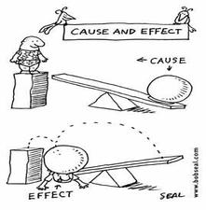
What is Experimental Design
Experimental Design is a logical, consistent process for stating and solving problems in the natural world.
Experiments are designed to show the cause & effect relationship

Slide 3
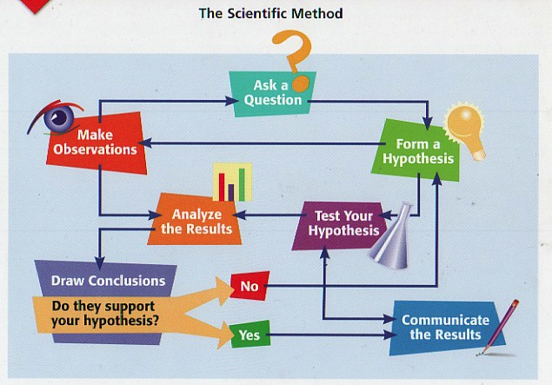
Steps in Experimental Design

Slide 4
A Good Experiment
Tests one variable at a time. If more than one thing is tested at a time, it won’t be clear which variable caused the end result
Must be fair and unbiased. The experimenter must not allow his or her opinion to influence the experiment
Does not allow any outside factors to affect the outcome
Is valid. The experimental procedure must test the hypothesis to see if it is correct or not
Has repeated trials. Repeating the trials in experiment reduces the experimental error and give more accurate conclusion

Slide 5
Experimental Research
Experimental research has two defining characteristics:
manipulation of one or more independent variables
control over dependent variables
An experimental method follows a standard form:
Subjects
Materials
Procedures
Measures

Slide 6
Experimental Research
Controlled experiments
Simulation and computational experiments
Surveys
Field studies
Quasi-experiments
…. …. …. much more

Slide 7
Controlled Experiments
One of the most common types of experiment is controlled experiment.
A controlled experiment is one in which everything is held constant except for one variable.
A control group in a scientific experiment is a group separated from the rest of the experiment where the independent variable being tested cannot influence the results.
Usually a set of data is taken for a control group, which is commonly the normal or usual state, and one or more other groups are examined, where all conditions are identical to that of control group.
Controlled experiment eliminate much of the uncertainty about the results. If you couldn't control each variable, you might end up with a confusing outcome.

Slide 8
Experimental Design
Includes planning in detail all the steps of the experimental phase. In engineering research it often includes the design of a prototype/system architecture.
Identify the variables that will be manipulated and measured – the research outcomes must be measurable.
What needs to be controlled in order to get an unbiased answer to the research question.
It is necessary to not only design a prototype/system but also the validation method.
How to validate the data?
Repeatability: The plan should allow others to repeat it.
It should be feasible.
Plan intermediate milestones.

Slide 9
Hypothesis Verification
Theoretical development
Logic and mathematics
Numerical simulation
Experimental measurement (particularly using standard tests)
Statistical analysis of measured data
Comparison with previously published research outcomes;
Multi-parameter optimization methods.
Prototyping

Slide 10
Theoretical Development
When developing a mathematical argument based on a set of theoretical equations, it is necessary to verify the solution.
Substitute their final equation back into the original equation to ensure that this provides a valid result;
Check that the solution lies within the expected physical limits;
Check the validity of the solution using mathematical programs;
Ensure that the result is reasonable (i.e. within expectation);
Verify the boundary conditions for the independent variables;
Make very slight changes to the material variables used in the model to ensure that the results do not change significantly

Slide 11
Numerical Modelling
Computing codes to model various physical effects.
E.g. codes in electromagnetics, computational fluid dynamics, and mechanical deformation (stress and strain) are now routinely used in predicting or verifying experimental measurements.
Ensure that the software model is valid by computing the solutions of standard models and comparing the results with theoretical calculations

Slide 12
Experimental Measurement
Standard measurement tools provide the best method of gaining reliable measurements.
For alternative measurement techniques, calibration procedure is required for verification.
Calibration procedures:
using provided standards (standard solutions in chemical analyses, standard loads for electric and microwave power level measurements, etc.),
the use of materials with properties that are well known, and
‘null’ calibration techniques when the instrument is run with a blank sample (e.g. air or pure water).
Additional verification by comparing measurements on materials and systems with the results from previously published refereed literature, but the source of the literature must be verified.

Slide 13
Simulation & Computational Experiments
Simulation is the imitation of the operation of a real-world process or system over time.
The act of simulating something first requires that a model be developed; this model represents the key characteristics, behaviours and functions of the selected physical or abstract system or process.
With responsive predictive power of simulation models, computational experiments have become a key element of science.

Slide 14
Simulation & Computational Experiments
A computational experiment is a computer simulation of a real experiment or a computer implementation of a thought experiment.
Computational experiments complement analytical theories and real experiments by providing a tool for explaining what was observed and predicting what will happen.

Slide 15
Computational Experiments ...
A computational experiment should include -
An application - a scientific problem of interest and the components of that problem that we wish to study and/or include.
Algorithm - the numerical/mathematical representation of that problem, including any numerical methods or recipes used to solve the algorithm
Architecture – a computing platform and software tool(s) used to compute a solution set for the algorithm.

Slide 16
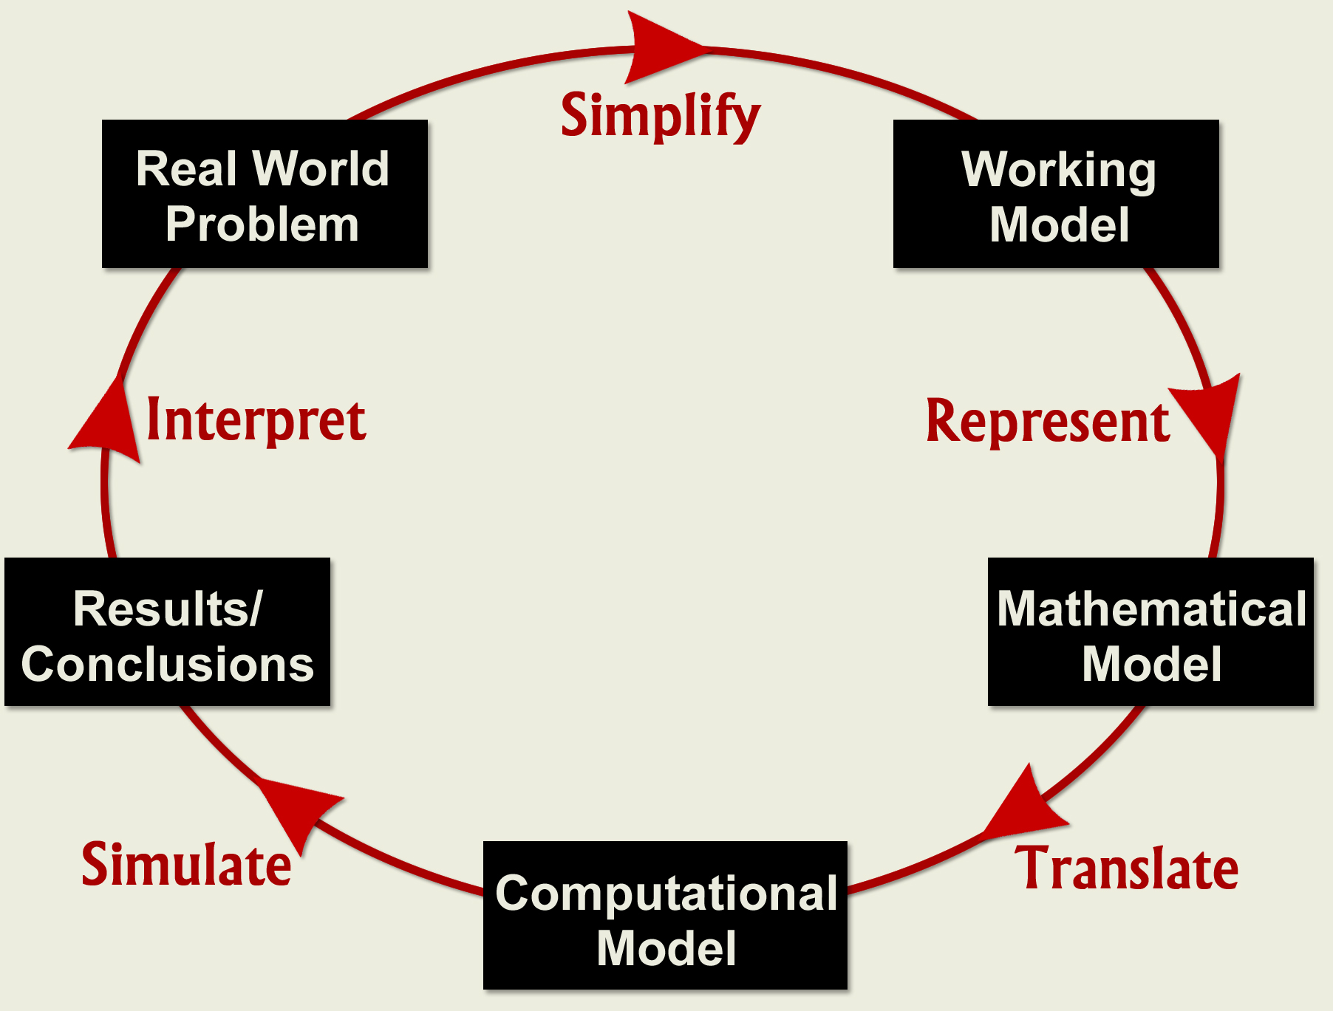
Computational Experiment Process

Slide 17
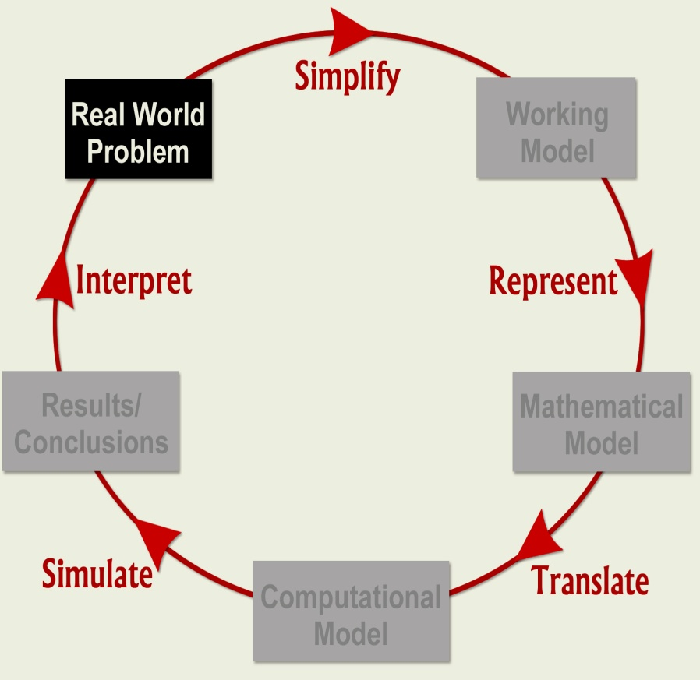
Identify Real World Problem
Perform background research, focus on a workable problem.
Conduct investigations (Labs), if appropriate.
Learn the use of a computational tool: C++, Java, Mathematica and so on.
Understand current activity and predict future behavior.

Slide 18
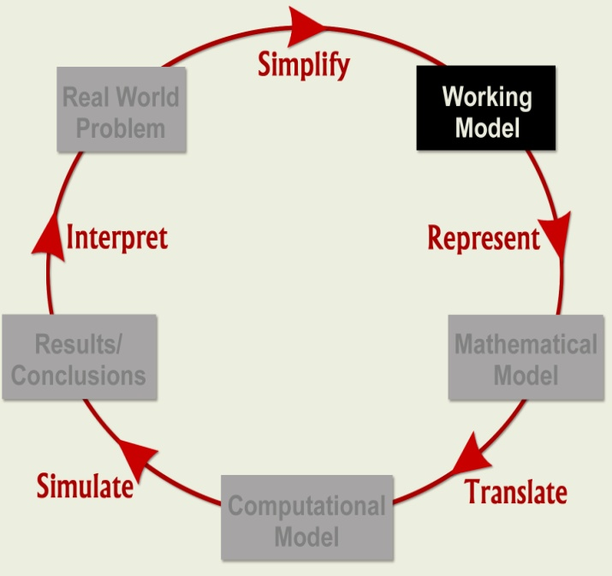
Simplify to Working Model
Identify and select factors to describe important aspects of Real World Problem
Identify those factors that can be neglected
State simplifying assumptions
Determine governing principles, physical laws
Identify model variables and inter-relationships.

Slide 19
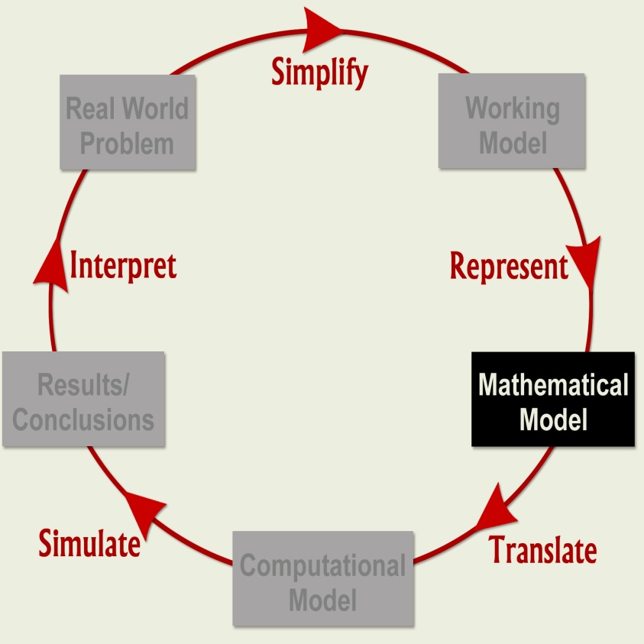
Construct the Mathematical Model
Express the Working Model in mathematical terms
Write down mathematical equations or an algorithm whose solution describes the Working Model.
Success of a mathematical model depends on how easy it is to use and how accurately it predicts.

Slide 20
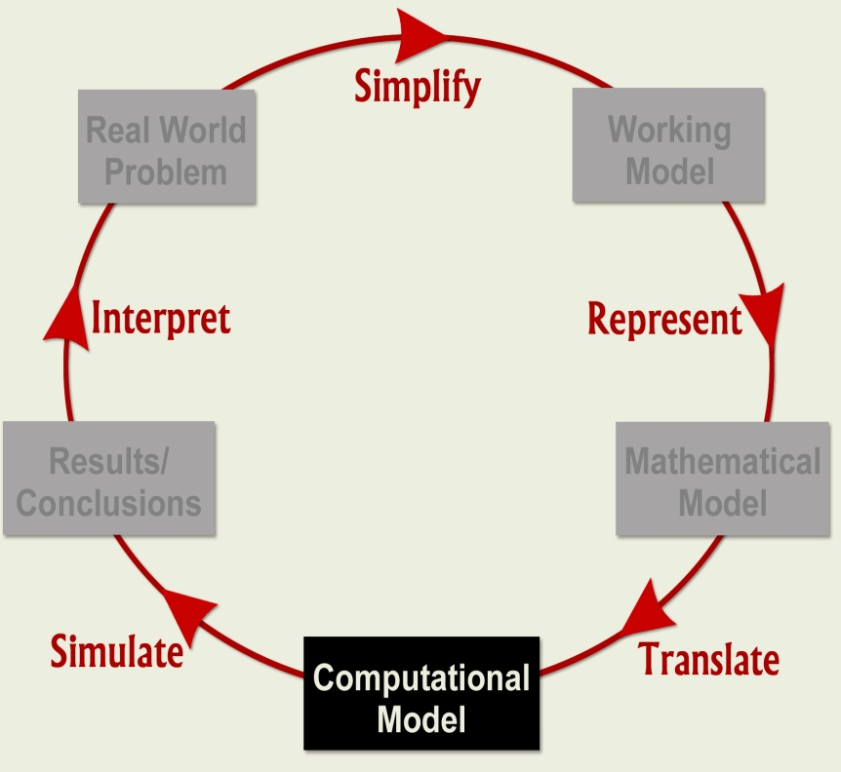
Translate into Computational Model
Change Mathematical Model into a form suitable for computational solutions
Computational models include languages, such as C++ or Java, or software, such as StarLogo, Stella, Excel, or Mathematica.

Slide 21
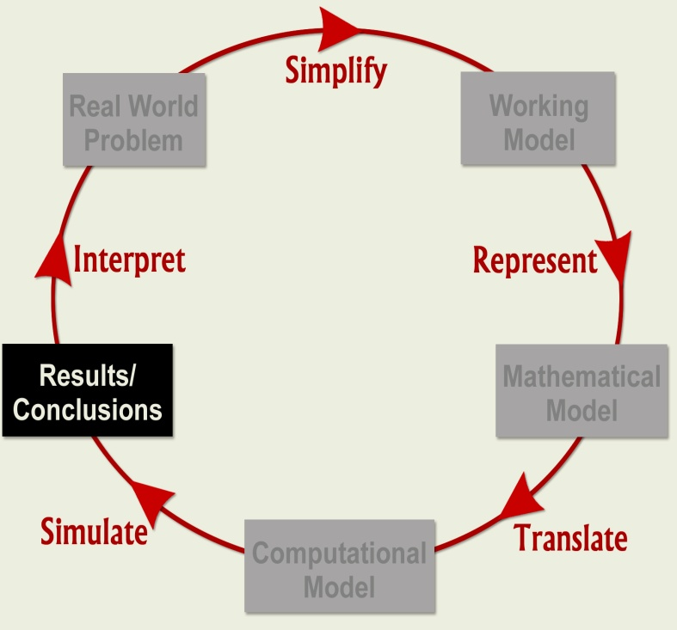
Simulate to Produce Results/Conclusions
Run the Computational Model to generate Results
Draw Conclusions.
Verify your computer program; use check cases; explore ranges of validity.
Graphs, charts, and other visualization tools are useful in summarizing results and drawing conclusions.

Slide 22
Interpret Conclusions
Interpret Conclusions in physical terms and compare with real world problem behavior.
If model results do not “agree” with physical reality or experimental data, re-examine the Working Model (relax assumptions) and repeat modeling steps
Often, the modeling process proceeds through several cycles until model is acceptable

Slide 23
A Virtual Laboratory
The site below is a digital library and virtual lab to visualize science projects in mechanics, electricity and magnetism, life sciences, waves, astrophysics, and optics.
It can be used to assist the development of mathematical models for your computational science projects.
https://www.explorelearning.com

Slide 24
Survey methods
A survey is a research technique, which is used to gather information from a sample of respondents by employing a questionnaire.
In survey, researchers seek information about and/or feedback from people on the outcomes or the proposed outcomes of the research, such as an issue/topic, a product or a service.
Surveys are normally carried out to obtain primary data

Slide 25
Designing a Survey
Develop the research plan
Design the survey instrument
Select the sample population
Issue/distribute the survey questionnaire
Prompt the sample population for responses
Analyse the data
Generate conclusions

Slide 26
Stakeholders
Select the sample population
Who are the stakeholders?
Why should they be interested?
Selection should be random from large population
Strong reason to defend the selected sample population

Slide 27
Types of Questions
Closed Format
Respondents are forced to choose between several given options.
Multiple choice, yes/no and ranking
Advantages:
Easy and quick to fill in
Easy to code, record, and analyze results quantitatively
Easy to report results
Disadvantages:
Respondents are required to choose a response that does not exactly reflect their answer
Researcher cannot further explore the meaning of the responses
Open Format
Respondents can formulate their own answers.
Use the open format if you are looking for respondents to provide specific comments or feedback.
Advantages:
Allows exploration of the range of possible themes arising from an issue
Disadvantages:
Time-consuming
Responses are difficult to code and interpret

Slide 28
How to ask questions?
Use short and simple sentences
Ask for only one piece of information at a time
e.g.: Please rate the Global Environment Class in terms of its content and presentation . This question should be divided into two parts:
Question one: Please rate the class in terms of its content
Question two: Please rate the class in terms of its presentation.
Avoid negatives if possible

Slide 29
How to ask questions?...
Some general rules are:
Go from general to specific
Go from easy to difficult
Start with closed format questions
Start with questions relevant to the main subject
Do not start with demographic and personal question
It is good to have a personalized cover letter or an introductory statement that
Explains the purpose of the survey,
Importance of the respondent’s participation
Person who is responsible for the survey

Slide 30
Anonymous Responses
Arguments for “yes” – Anonymous
Sample population might be less influenced by who is asking the questions
Respondents might be less concerned about others learning of their opinions
Arguments for “no” – Non-anonymous
Who will you send the results to?
Who will you send the reward to?
How do you know who to follow up about returning the survey?

Slide 31
Missing Data
Did the respondent simply forget one question?
Was the question not relevant to that person?
Was the question too personal?
Was the question confusing?

Slide 32
Confidentiality & Feedback
Confidentiality:
You need to ensure that confidentiality is assured before the survey is sent out.
Consider using an independent third party to administer the survey.
There are surveys which asked for sufficient personal information to be identified uniquely.
Feedback:
It is assumed that the population under survey will want access to results.
You must explain how will this be accomplished at the beginning of the survey

Slide 33
Compiling the Survey Data
After researchers receive the completed questionnaires, the task of summarizing the results remains.
The total size of the sample and total percentage of returns should be reported.
The percentage of the total sample responding for each item should be reported.
The percentage of respondents who chose each alternative for each question should be given.
A good software for compilation and analysis of survey data:
SPSS developed by IBM

